Slide 1
Air pollution trends assessed by the Working Group on Effects
With the agreeable contributions of :
heleen.de.wit@niva.no, ICP Waters (coordinator of WGE Trends report),
Walter Seidling, ICP Forests,
Martin Forsius, Lars Lundin, ICP Integrated monitoring,
Harry Harmens, Gina Mills, ICP Vegetation,
anne-christine.le-gall@ineris.fr, ICP Modelling & Mapping
Jean Paul Hettelingh, Max Posch and Jaap Slootweg, CCE
Johan Tidbald, ICP Materials,
Filip Moldan, Joint Expert Group on Dynamic Modelling,
Marie Ève Héroux, Task Force on Health,
And the bureau of the Working Group on Effects.

Slide 2
What can be learnt from more than 25 years of work on effects on air pollution within the UNECE community?
Introduction
Work within the Working Group on Effects is a long story of exchanges between monitoring and modelling communities
EMEP data
Modelling
Monitoring
Dose response functions
Critical loads and levels
Area average exceedances
Target loads
PODy
Acceptable corrosion rates
Air quality guidelines
YOLL
DALY
…
Waters
Forests
Mosses
Lichens
Grasslands
Glass
Built structures
Epidemiology

Slide 3
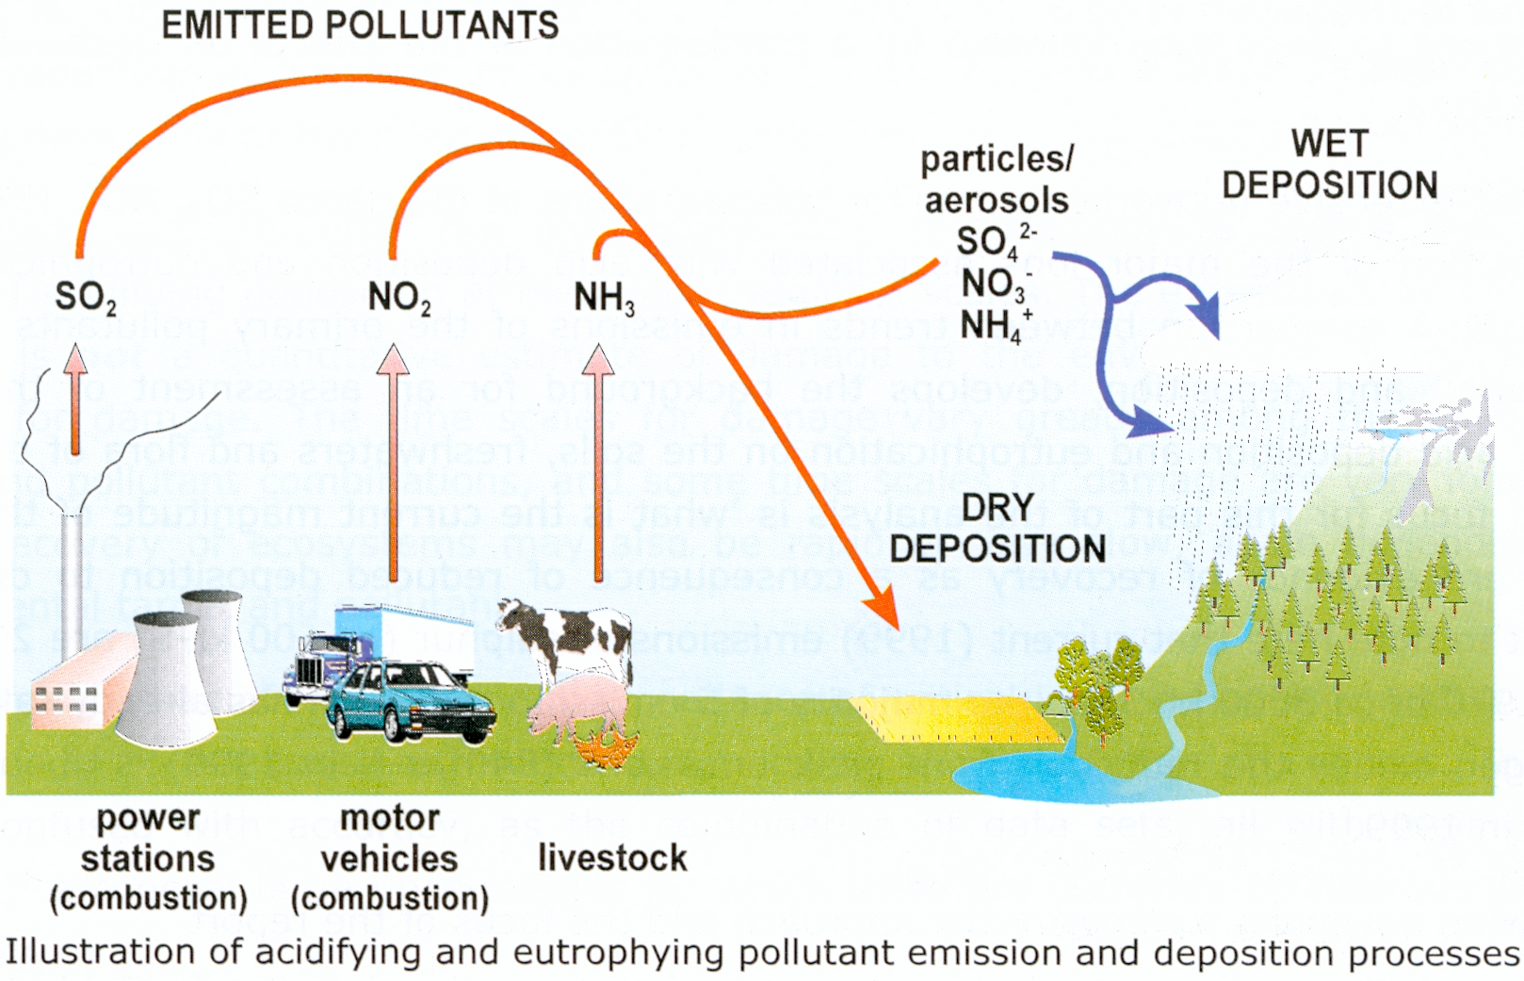
Effects of atmospheric pollution on human and its environment are now well established
Effects
  S+N => corrosion of materials
  PM => human health and soiling
  O₃ => damages on vegetation, crops, human health
  S+N => soils and water acidification
  N => soil and water eutrophication, biodiversity decline
  Heavy metals (& POPs) => vegetation, biota, human health
Critical
Levels
Critical
Loads

Slide 4
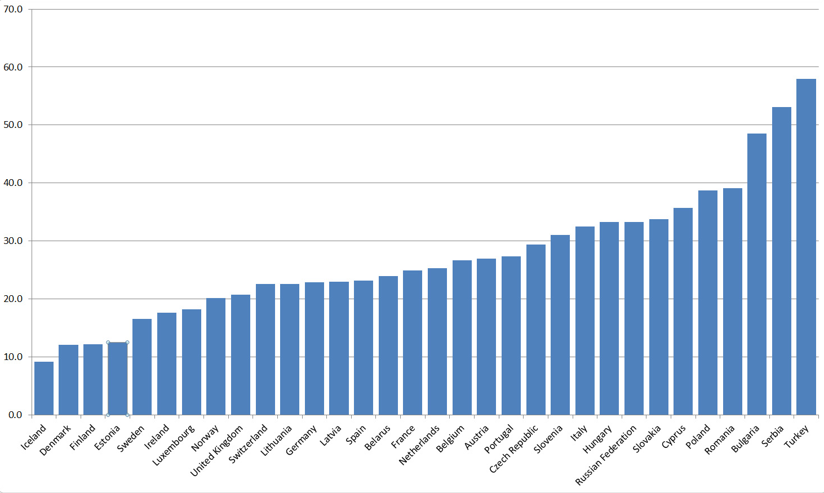

Human health in urban areas is affected by ozone and PM₁₀ levels above WHO AQ Guidelines
Effects
24 h mean
PM₁₀, µg/m³
Year: 2011
60
40
WHO
AQG =
20 µg/m³
0
TF Health
  Source: ENHIS database, WHO
Notes:
ENHIS database
Indicators PM2.5, PM10, ozone
From EEA and national sources
Theoretically all 53 Members States of the WHO European Region
EU reference value for PM10 is 40µg/m3, and this implies that only 33% of the urban population in Europe is exposed above the threshold value (instead of 88% with the WHO AQG).
Ambient air pollution contributes to significant burden of lower respiratory tract infections, lung cancer, cardiovascular disease, COPD, asthma, other respiratory diseases. Chronic diseases in adults (mainly cardiovascular and circulatory diseases) are the dominant health outcome.
the recent Global Burden of Disease project, which estimated DALYs for a variety of causes of disease and risk factors. The comparative risk assessment at global level shows that household (indoor) air pollution and ambient (outdoor) air pollution are ranked 4th and 9th causes of death and disease worldwide in 2010.
Household air pollution from solid fuels a leading risk factor, particularly for low income countries

Slide 5
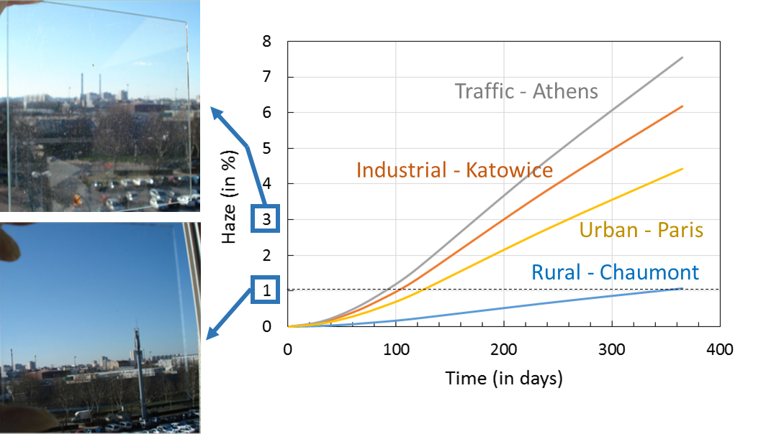
Air pollution corrodes and soils materials increasing maintenance costs for built structures
Effects
Haze on glass (%)
Exposition time of glass panes (in days)
ICP Materials
Notes:
Figure 2.5: Predicted haze (in %) as a function of exposition time for 4 types of sites: rural, urban, industrial and traffic. Input environmental data for the 2008-2009 campaigns were selected (Lombardo et al., 2014). Visual aspects are shown on 2 pictures: Katowice after 1 year (haze = 3%), upper image and Chaumont (haze = 1%), lower image.
ICP Mat Report No 76:
Trends in pollution, corrosion and soiling 1987-2012

Slide 6
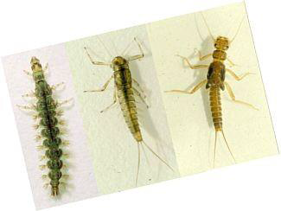
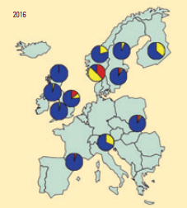
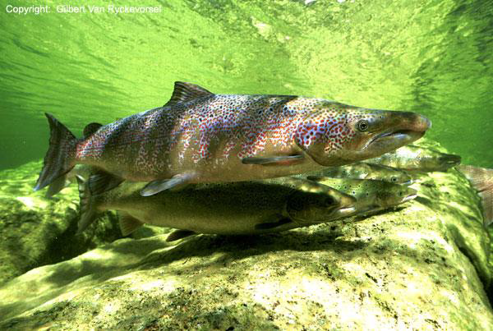

In rivers and lakes, acidification impacts have been reduced but there are still regions with little signs of improvements
Effects
“Freshwater acidification is still above critical loads for 10 % of land area in Norway” B.A. Saether, TFIAM workshop, 2013
ICP Waters
  Recovery of acidified European Waters
  Wright et al, ES&T, 2005
Notes:
Norway-Zagreb-korr.pptx
Biodiversity in freshwaters: temporal trends
and response to water chemistry, Velle et al, 2013, ICP Waters report 114/2013
Figure too
The data-analysis suggests that improved species diversity and declining sulphate are correlated.
Reductions in sulphate concentrations in acid-sensitive catchments, resulting from reductions in
sulphur deposition, are a driver of changes in pH and aluminium, both of which are associated with
toxic effects on aquatic biota. In terms of community response, the timing of the recovery and the
biological characteristics of the recovery is nonlinear and non-comparable among sites. This suggests
that future biological recovery to acidification will not show a universal pattern across sites.

Slide 7
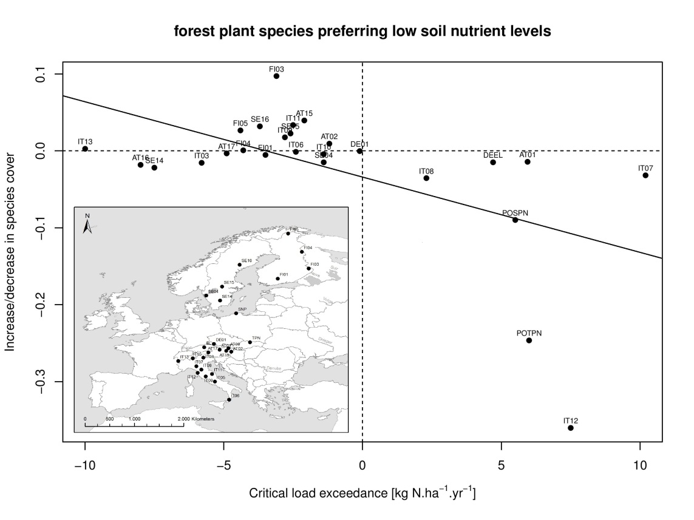
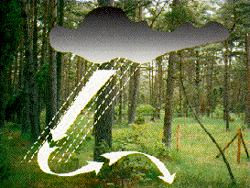

Observations in forests provided evidence for a decline in biodiversity when critical loads are exceeded
Effects
Forests plant species preferring low soil nutrient levels, dry and acid soils showed the strongest downward trend during the last 10-20 years.
increase
Species cover
decrease
R²=0.3
p-value=0.004
ICP Integrated Monitoring
Nitrogen critical loads exceedance (kg/ha/an)
Excess Nitrogen
  Dirnböck, T., et al, 2014. Global Change Biology.
Notes:
Dirnböck, T., Grandin, U., Bernhardt-Römermann, M., Beudert, B., Canullo, R., Forsius, M., Grabner, M.-T., Holmberg, M., Kleemola, S., Lundin, L., Mirtl, M., Neumann, M., Pompei, E., Salemaa, M., Starlinger, F., Staszewski, T., Uziębło, A.K. 2014. Forest floor vegetation response to nitrogen deposition in Europe. Global Change Biology 20: 429-440.

Slide 8
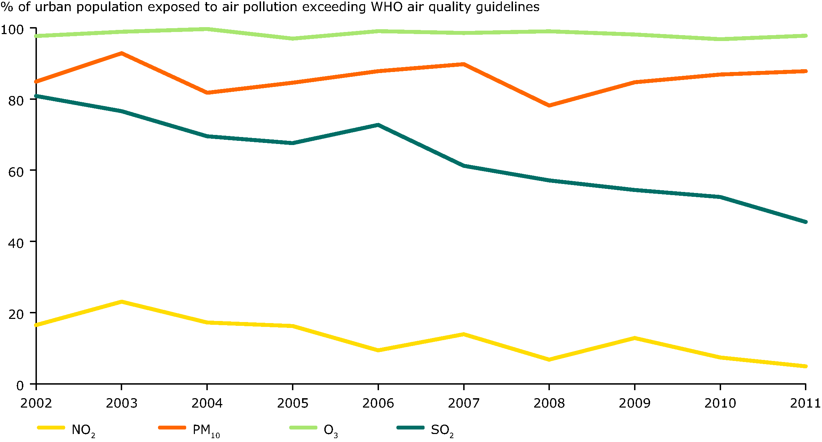

Exposure of human to atmospheric pollutants continues causing lung and heart diseases
Trends
% of EU urban population exposed to air pollution exceeding WHO 2005 air quality guidelines
100
Ozone
PM₁₀
80
60
40
SO₂
20
NO₂
2002
2004
2006
2008
2010
TF Health
  Source: European Environment Agency (EEA),
  http://www.eea.europa.eu/data-and-maps/figures/percentage-of-the-eu-urban
Notes:
- These data are available from the EEA and provides an overview of the situation at European level for the latest years with data available.
- in many cases the latest WHO guidelines from 2005 are not met, this is especially the case for PM, ozone, and benzo[a]pyrene.

Slide 9
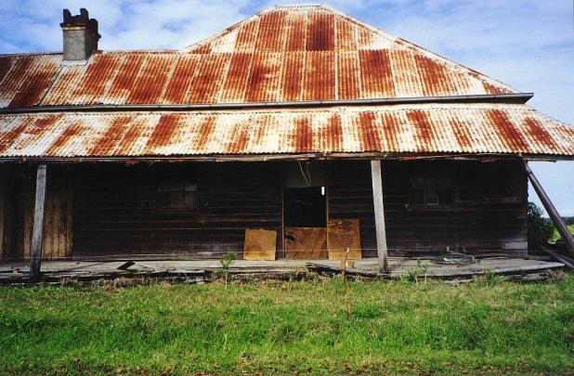
Over the last 20 years, corrosion rates have globally decreased on ICP Materials observation sites
Trends
SO₂ concentrations (µg/m³)
Losses due to corrosion (µm)
0
Year
Corrosion losses averages on 20 ICP Materials sites across Europe
  Tidblad et al, 2014, ICP Materials N°76
Notes:
Corrosion has decreased substantially to around 50% of the original values measured in 1987. In recent years, however, the improvements in corrosion and soiling are minor. For real cultural heritage objects made of metals the decreases are instantaneous, responding rapidly to decreasing pollution levels. For stone materials, however, there is a substantial time lag, 20 years or more, before improvements can be seen.

Slide 10
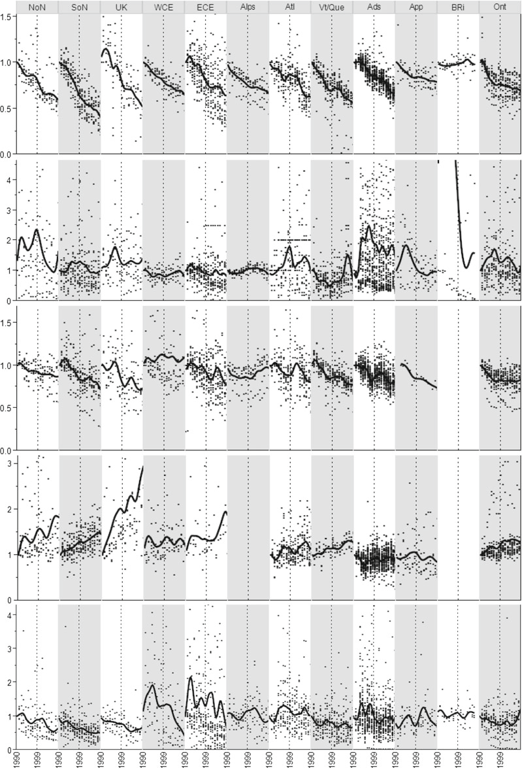
Observations by ICP Waters have shown trends in chemistry and biology in different regions
Trends
EMEP domain
North America
SO₄*
Nitrate trends are less uniform and over a smaller range
pH, alkalinity and acid neutralising capacity tend to flatten after 1999
Chemical recovery paves the way to biological recovery
ICP Waters
  Garmo et al, 2014, Water Air and Soil Pollution
Notes:
Garmo, O. A., Skjelkvale, B. L., de Wit, H. A., Colombo, L., Curtis, C., Folster, J., Hoffmann, A., Hruska, J., Hogasen, T., Jeffries, D. S., Keller, W. B., Kram, P., Majer, V., Monteith, D. T., Paterson, A. M., Rogora, M., Rzychon, D., Steingruber, S., Stoddard, J. L., Vuorenmaa, J., and Worsztynowicz, A. (2014). Trends in Surface Water Chemistry in Acidified Areas in Europe and North America from 1990 to 2008. Water Air and Soil Pollution, 225, 3, 14. <Go to ISI>://WOS:000334577800007
Biodiversity in freshwaters: temporal trends
and response to water chemistry, Velle et al, 2013, ICP Waters report 114/2013
The data-analysis suggests that improved species diversity and declining sulphate are correlated.
Reductions in sulphate concentrations in acid-sensitive catchments, resulting from reductions in
sulphur deposition, are a driver of changes in pH and aluminium, both of which are associated with
toxic effects on aquatic biota. In terms of community response, the timing of the recovery and the
biological characteristics of the recovery is nonlinear and non-comparable among sites. This suggests
that future biological recovery to acidification will not show a universal pattern across sites.
Globally, the species diversity of freshwaters is declining, while the species diversity of the sites in the
present study is increasing.

Slide 11
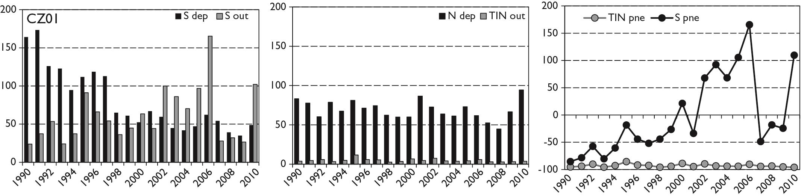
In forest catchments, S release has been larger than S deposition since 2000 while deposited N remained stored
Trends
% net export
S
Exemple from one site in Czech Republic
ICP Integrated Monitoring
N
Notes:
http://www.unece.org/fileadmin/DAM/env/documents/2014/AIR/WGE/ICP_Waters_WGE_sept_2014.pdf
Preliminary conclusions
•Decreased sulphate deposition drives trends in chemical recovery
•Variations in observed water chemistry relate partly to climate
–Evaluation of model description of observations = ground truthing
•No significant chemical recovery is expected in 2020
•Climate-related variation in water chemistry is significant and will affect chemical recovery
http://www.unece.org/fileadmin/DAM/env/documents/2014/AIR/WGE/ICP_IM_Activities_WGE__2014_LL_MF.pdf
budgets for catchment ecosystems show leaching of SO4 but no change in retention of nitrogen.
S and N budgets and retention for ICP IM site CZ01
Pne: percent net export

Slide 12
PCB concentrations in fish are decreasing as a consequence of regulation
Trends
PCB in pike muscle, Sweden
ICP Waters
  ICP Waters report 2005

Slide 13

Decline heavy metal concentration mosses supports EMEP modelled deposition (1990 – 2010)
Trends
Cadmium
Lead
Mercury
Black line: concentration in mosses, blue dots: EMEP modelled deposition
  Also moss concentrations available for arsenic, chromium, copper, iron, nickel, vanadium, zinc
  Antimony and nitrogen moss concentrations available for 2005 - 2010
ICP Vegetation

Slide 14
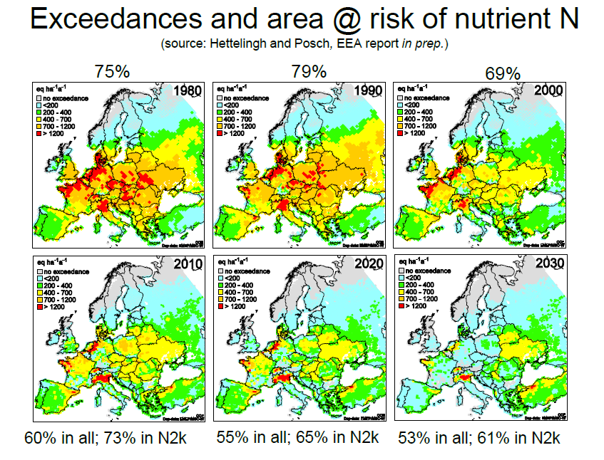

Exceedances and areas at risk of nutrient nitrogen are decreasing but still concern more than 50% of Europe
Trends
55 % in all;
65% in Natura 2000
75 %
69%
1980
2000
2020
Trends are calculated via critical loads modelling on ecosystems and protected areas (Natura 2000) using EMEP modelling as inputs
CCE & ICP M&M
  Hettelingh et al, 2014, EEA Technical Report 11

Slide 15
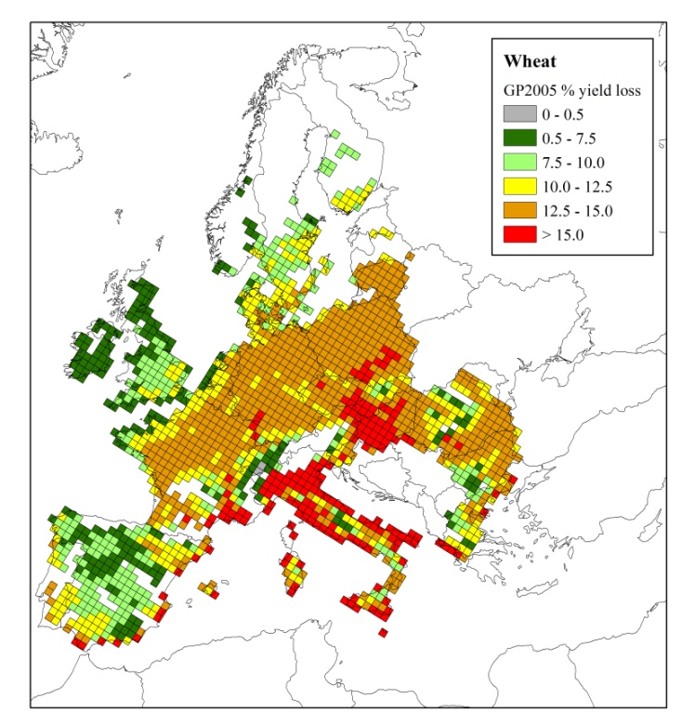
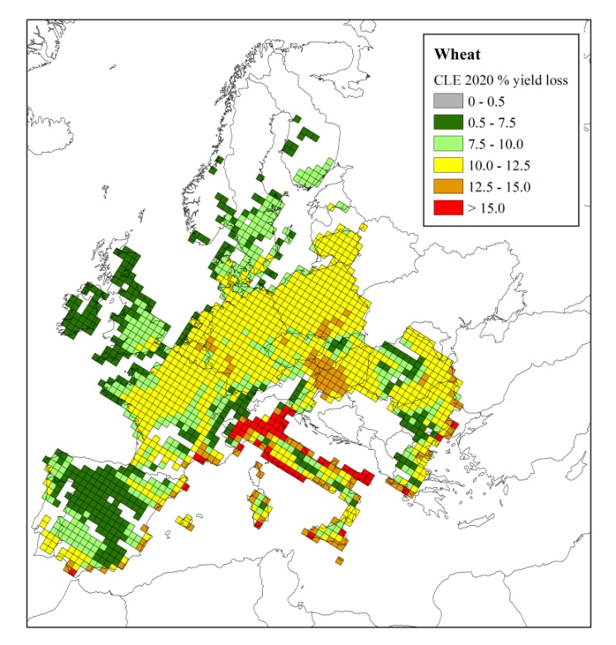
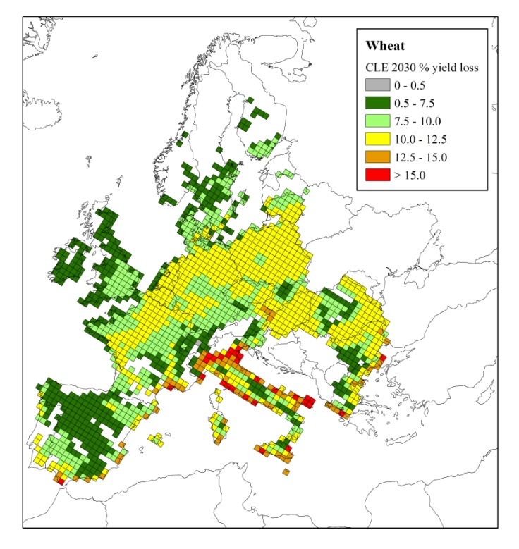
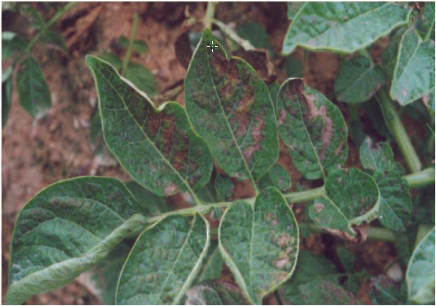
Critical level approach is used to assess the evolution of yield loss wheat due to ozone
Trends
GP 2005
GP CLE2020
GP CLE2030
10.7% loss
8.8% loss
8.2% loss
Will EMEP calculate POD₁, AOT40, SOMO₃₅ or only ozone concentration?
Percentage yield loss – calculated using a new response relationship for the generic crop flux model (POD_{3IAM})¹
ICP Vegetation
¹ assumes soil water is not limiting
Notes:
Future modelled trend ozone to emphasise future challenges. Note: By March 2015 we also intend to produce a trend report on rising background ozone concentrations and implications for impacts on vegetation (EMEP will h
ave data on background ozone concentration trends).
Might be worthwhile to ask whether EMEP will study trends of ozone matrices such as POD1, AOT40 and SOM35 too or whether they will only study ozone concentrations in air (and leave the other analyses to ICP Vegetation and TF Health).

Slide 16

The worst may have been avoided but effects monitoring and modelling show that there are still problems ahead of us
Trends
Area at risk of acidity
and nutrient nitrogen
Exceedances of critical
loads of acidity
and nutrient nitrogen
CCE & ICP M&M
Source: CCE

Slide 17
Comparisons of effects trends with depositions and emissions trends contribute to a better understanding of processes, delay times and policy efficiencies
Conclusion
Trends of effects of air pollution on ecosystems have been compiled over 20-25 years of monitoring across Europe and North America
  Compilations cover all ecosystem types
  Compilations cover a large variety of pollution ranges
Effects trends (monitoring and modelling) show successes of reduced pollution and areas where questions remain
  Variability in ecosystem types and sensitivity
  “Confounding factors” : climate change, land use,…
  Delay times between deposition, chemical response and biological recovery
Effects trends serves various policies
  Air pollution
  Natura2000
  EU biodiversity
  Convention on biological diversity
Notes:
Biodiversity in freshwaters: temporal trends
and response to water chemistry, Velle et al, 2013, ICP Waters report 114/2013
This international, quality controlled long term monitoring of water chemistry and biota in acidsensitive
waters have been important in tracking changes in the diversity of invertebrates in these
ecosystems, and their possible causes, i.e. air pollution. Reduction in the emissions of acidifying
pollutants has been followed by a positive development in the species diversity of acid-sensitive
freshwaters, in sharp contrast to the global trend of decreasing freshwater species diversity.

Slide 18

Trend assessment report WGE
Trend assessment report
Discussed at WGE meetings in March and September 2014
Coordination: Heleen de Wit, ICP Waters
Agreed to make a trend report based on existing trend analyses, not start entirely new trend analyses
  A new analysis would need resources that are already allocated to other work
The trend report should feed into the WGE-EMEP assessment report
Structure of the report
  Organized by pollutant
  Period: 1990-2012 (preferably)
  Methods: as this trend analysis is based on existing trend analyses, difficult to make demands. Mann-Kendall tests, preferably.

Slide 19
Contribution from EMEP to WGE assessment (on going discussion)
Trend assessment report
For each pollutant, it would be great to get trends in emissions and (measured) deposition (and/or concentrations) for 1990-2012
  For Europe (and nice to get North America)
  Perhaps divided into smaller regions
EMEP contributed earlier to an ICP Waters trend assessment, where trends in deposition for S and N for Europe (1990-2008) were calculated using a Mann-Kendal test.
  Trends in precipitation chemistry (SO₄, NO₃, NH₄, base cations and H⁺) from 27 European sites (EMEP) and 34 North American sites)
    for the period 1990-2008,
    for the two 10-year periods 1990-1999 and 1999-2008.

Slide 20
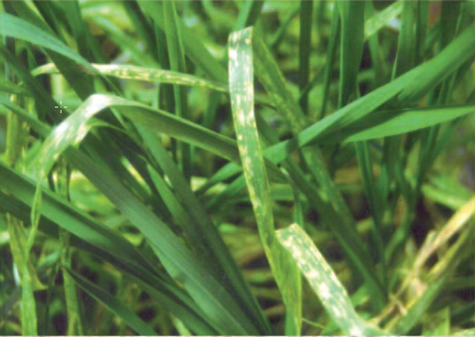

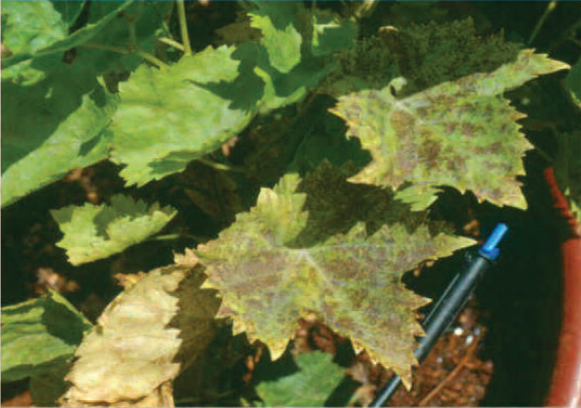
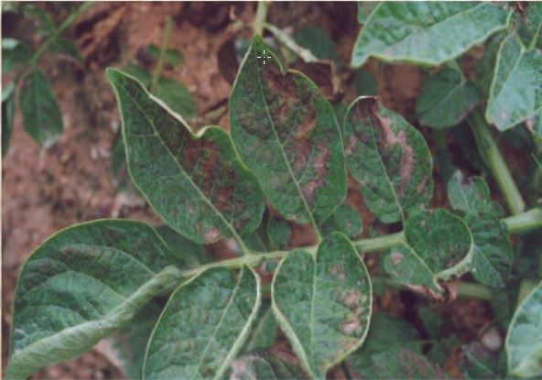
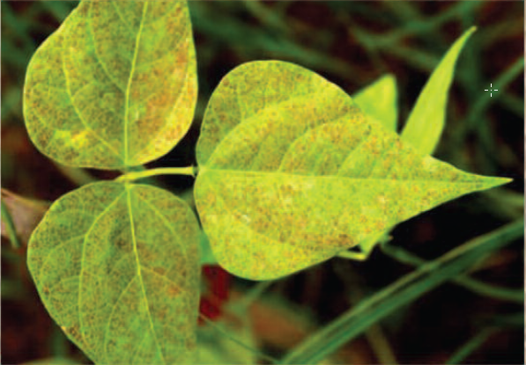
Thank you for your attention

Slide 21
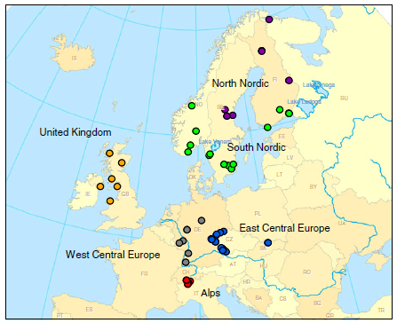
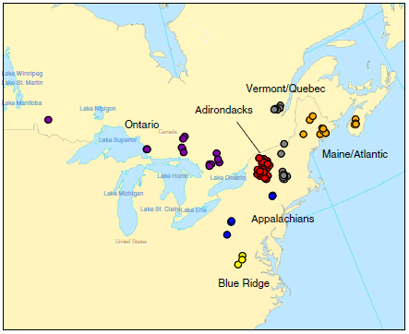
ICP Waters regions
ICP Waters
  Garmo et al, 2014, Water Air and Soil Pollution

Slide 22
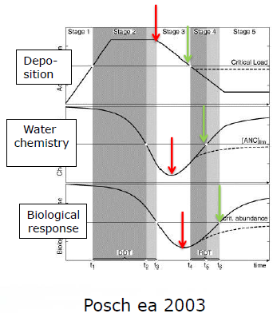
A systematic comparison with air quality trends may help to understand delays in the observation of effects after emission have been reduced.
Delays could be different for different pollutant and/or different ecosystem types
Delays are important to know because they may affect the valuation of the effectiveness of the emission reduction

